Slide 1
Case Study: Analysis of Cardiotocography Features and their Impact on Foetal Health
Thomas Amogolla Tsuma

Slide 2
Overview
Introduction
Proposals from scientific literature
Results from my trial
Model training methodolody
Model evaluation
Future steps

Slide 3
Introduction
The aim of this exercise if to determine develop a machine learning model to classify fetal health as 1-Healthy, 2-Suspicious, and 3-Pathological
This method forms a supplement to gynaecology and cardiotocograph analysis by human beings both of which are fairly subjective.
The proposed solution is meant to reduce overtreatment in the form of unnecessary C-section treatments while also minimizing undertreatment which may cause harm to the fetus and the mother.
The dataset comprises of 21 features and one target variable with three discrete values meaning it is a multiclass classification problem

Slide 4
Proposals from scientific literature
Obstetrics and gynaecology accounted for approximately 50% of clinical negligence claims of this nature whereas CTG misinterpretation, mismanaged labor and cerebral palsy comprise the other half.
This is because visual CTG analysis is subjective and without recall ability of previous values, it is possible to misinterpret and misdiagnose pregnant women.
Hence the inclusion of machine learning is necessary so as to improve accuracy of analyzing CTG data and improving speed as well.

Slide 5
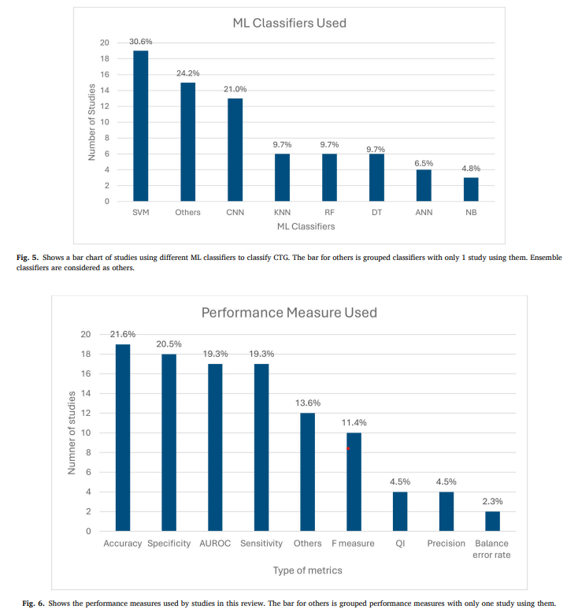
Results from previous study
Here is a look of how many research paper referenced machine learning and the algorithms they elected to use:

Slide 6
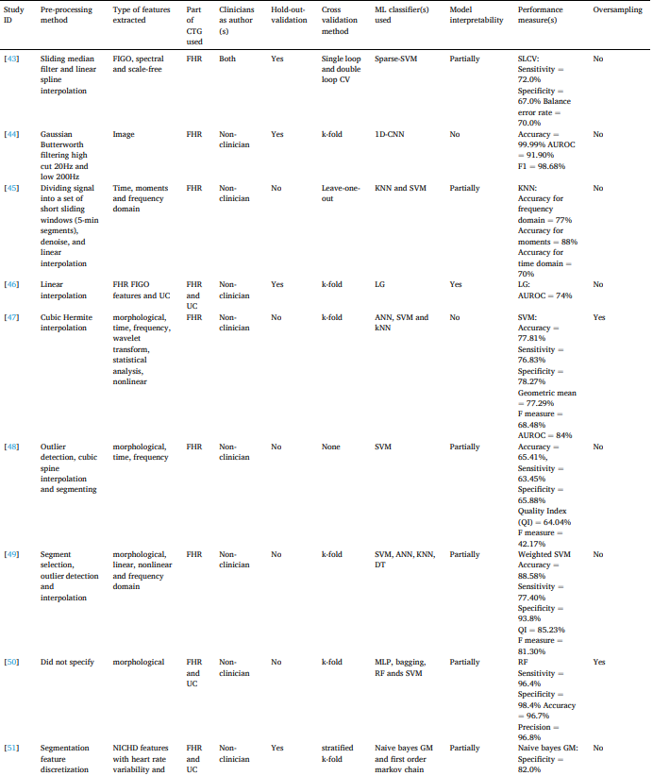
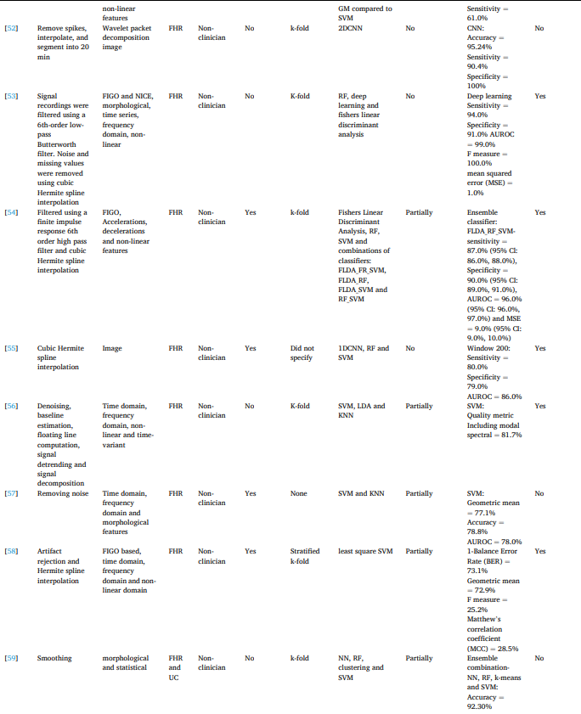
Results from previous study
Here is a breakdown of some of the methods and results:

Slide 7
Exploratory Data Analysis
Certain factors help to determine suitability of data for modeling:
Size of the dataset
Precise, feature rich attributes
Missingness
Consistency of values
Normality of distribution
Sampling fairness

Slide 8
Size of Dataset
A general rule of thumb to decide on whether traditional machine learning or deep learning should be used is that there should be around 5000 instances of each category in the dataset
Dataset
Can an arbitrary function solve the problem
Use arbitrary function as it increases interpretability
Y
N
Does each category have > 5000 instances
Y
N
Use Deep learning
Use Machine Learning

Slide 9
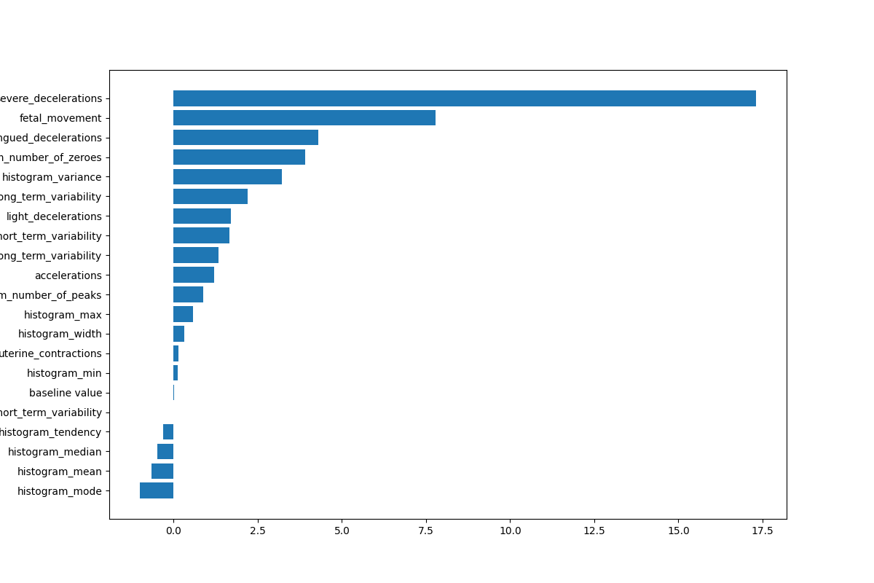
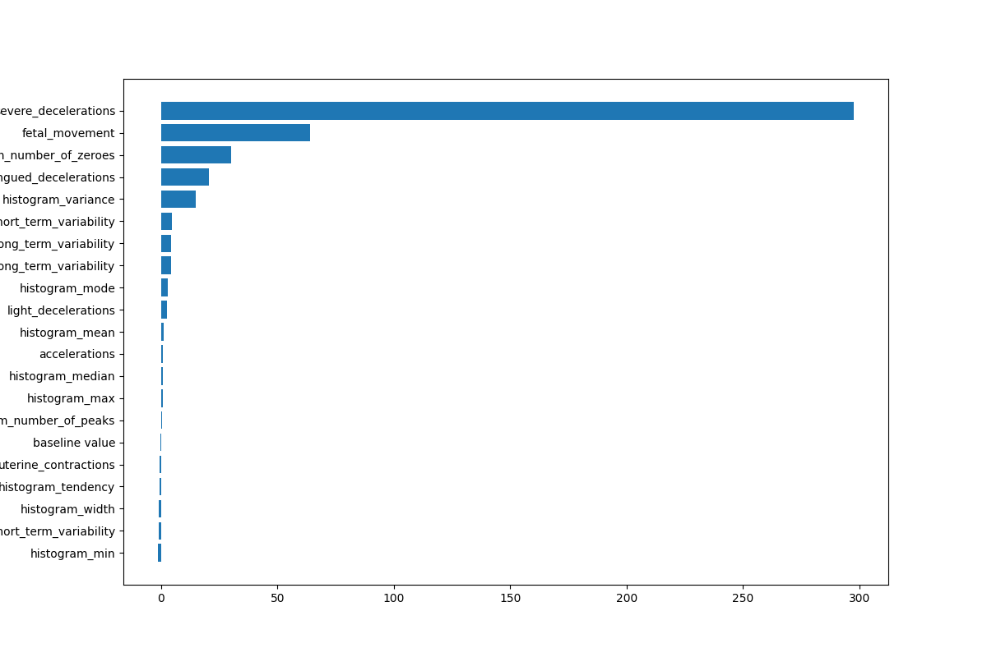
EDA Steps
The initial steps involved removing duplicates (13) and handling missing values(0). Best way to handle missing values would have been to use KNN Regressor to impute values based on neighbors. I also added certain checks for abnormal data such as the percentage values cannot be larger than 100 and max FHR cannot be lower than min FHR.
Skewness
Kurtosis

Slide 10
Data validity checks were done to ensure each column only contains numerical data. To avoid instances of misinputs.
A bias report helps to identify how the different classes are distributed among the different features. This could possibly indicate that sampling was not fairly done. Improper sampling can lead to the model gaining unintended information.
Healthy
abnormal_short_term_variability | count
32 | 523
49 | 491
61 | 415
87 | 217
Pathological
abnormal_short_term_variability | count
32 | 13
49 | 7
61 | 32
87 | 123
Suspicious
abnormal_short_term_variability | count
32 | 10
49 | 30
61 | 89
87 | 163
Here, we can see that there were much fewer instances of healthy patients with abnormal_short_term_variability of 87. Majority of pathological instances had an abnormal short_term_variability of 87. Same for suspicious instances

Slide 11
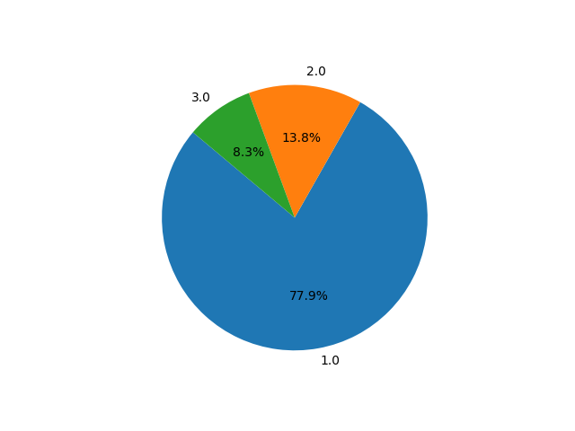
The data is imbalanced, necessitating certain evaluation strategies:
Consider other evaluation metrics other than accuracy.
SMOTE oversampling technique

Slide 12
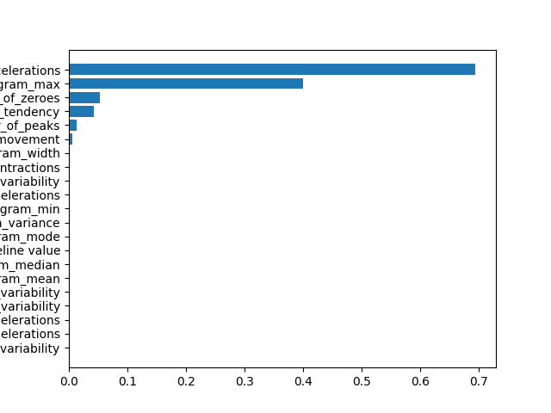
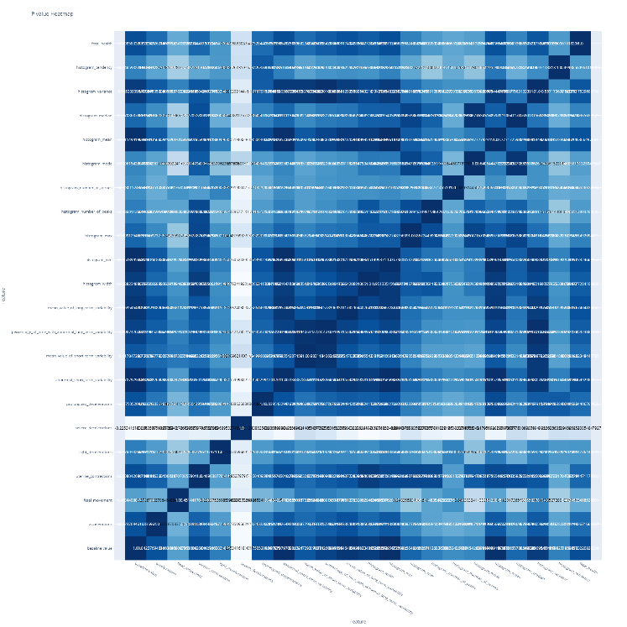
Feature and target correlation
Different tests were done to determine the relationship of features to each other and to the target variable including a Kolmogorov-Smirnov Test to determine similarity of distribution and normality, a chi-squared test, and Pearson’s correlation test of features.
Inverted bargraph of chisquare test between each feature and the target
Chi-Square Heatmap
Increasing intensity means a stronger relationship
Comparing these chi square values can help determine features that are strongly correlated to the target variable

Slide 13
A Kolmogorov-Smirnov test helps to determine combinations of features and target variables which have similar distributions:
KS-Test of Distribution
columns | p_values
baseline value | 0
accelerations | 0
fetal_movement | 0
uterine_contractions | 0
light_decelerations | 0
severe_decelerations | 0
prolongued_decelerations | 0
abnormal_short_term_variability | 0
mean_value_of_short_term_variability | 0
percentage_of_time_with_abnormal_long_term_variability | 0
mean_value_of_long_term_variability | 0
histogram_width | 0
histogram_min | 0
histogram_max | 0
histogram_number_of_peaks | 0
histogram_number_of_zeroes | 0
histogram_mode | 0
histogram_mean | 0
histogram_median | 0
histogram_variance | 0
histogram_tendency | 0
Our null hypothesis(H0) was that the feature had a similar distribution to the target and could only be negated with a p-value greater than 0.05

Slide 14
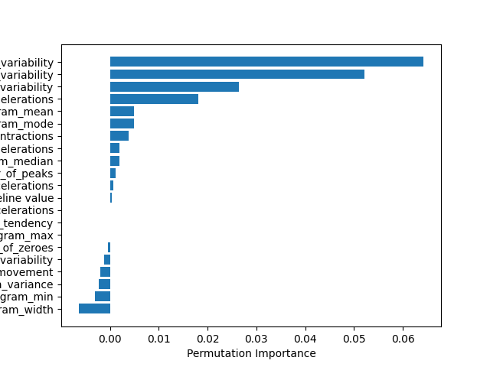
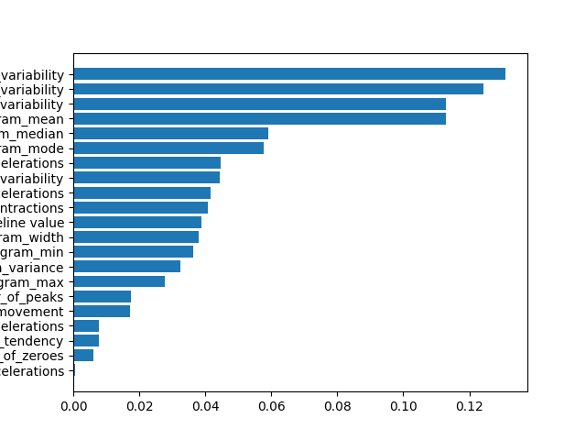
Also to determine feature importance when predicting target, we calculate RandomForestClassifier’s feature importances and permutation importance
RandomForest Feature Importance
RandomForest Permutation Importance

Slide 15
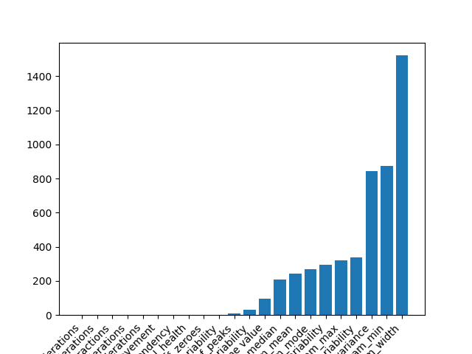
Determine Column Variance
Columns with little or no variance do not have any information value and my only increase model complexity
A caveat here is that low variance may be due to very low values.
Column Variance

Slide 16
Handling non normal distributions
While random forest is robust to non-normal data, it may help to also transform data to get a normal distribution.
Determine columns that could benefit from log transformation to become normal.
Criteria for normal data is that greater than 60% (around 68%) of the data points are 1 standard deviation from the mean and greater than 90%(93%) of data are two standard deviations from the mean.
column | percent_one_std_away_from_mean | percent_two_std_away_from_mean
baseline value | 64.55277 | 95.92996
abnormal_short_term_variability | 67.34501 | 96.78183
mean_value_of_short_term_variability | 67.58164 | 96.49787
histogram_width | 67.62896 | 95.88263
histogram_min | 58.49503 | 100
histogram_max | 68.14955 | 96.63985
histogram_mode | 80.0284 | 96.40322
histogram_mean | 74.25461 | 95.4567
histogram_median | 71.88831 | 95.78798
fetal_health | 77.89872 | 91.71794

Slide 17
Dimensionality Reduction
Different techniques were tested for dimensionality reduction and their effect assessed on the model accuracy:
Factor Analysis
Feature Importance
Classification Report Metrics after applying Feature Importance(n=15)
Classification Report Metrics after applying Factor Analysis
 | precision | recall | f1-score | support
1 | 0.916667 | 0.974684 | 0.944785 | 316
2 | 0.692308 | 0.482143 | 0.568421 | 56
3 | 0.666667 | 0.444444 | 0.533333 | 9
accuracy | 0.889764 | 0.889764 | 0.889764 | 0.889764
macro avg | 0.758547 | 0.633757 | 0.68218 | 381
weighted avg | 0.877785 | 0.889764 | 0.879747 | 381
 | precision | recall | f1-score | support
1 | 0.892989 | 0.979757 | 0.934363 | 247
2 | 0.925 | 0.72549 | 0.813187 | 102
3 | 0.966667 | 0.90625 | 0.935484 | 32
accuracy | 0.905512 | 0.905512 | 0.905512 | 0.905512
macro avg | 0.928219 | 0.870499 | 0.894345 | 381
weighted avg | 0.907747 | 0.905512 | 0.902016 | 381

Slide 18
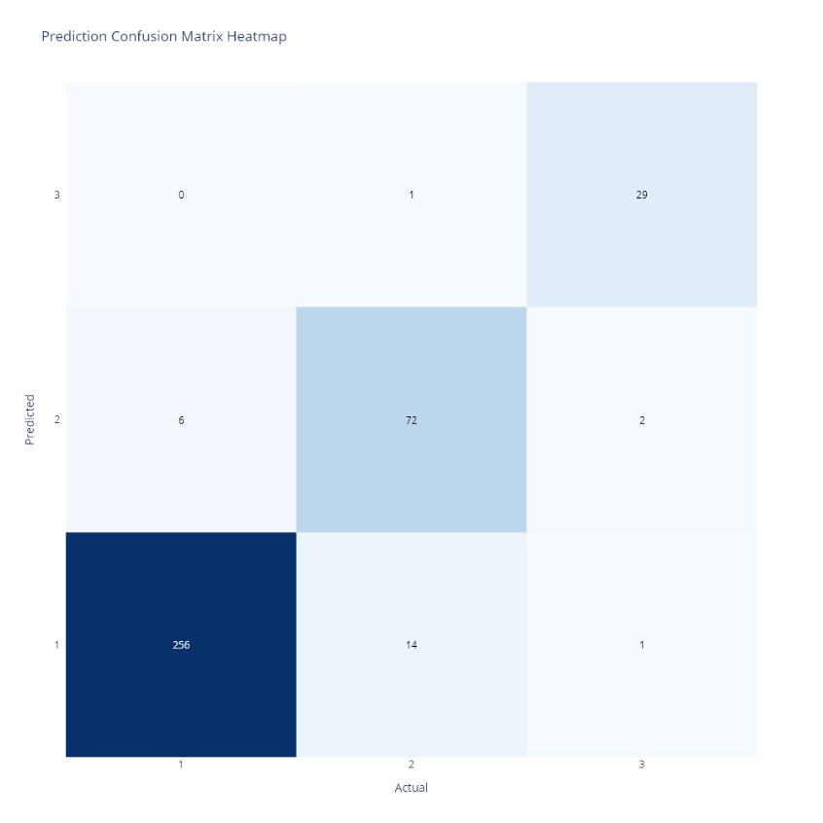
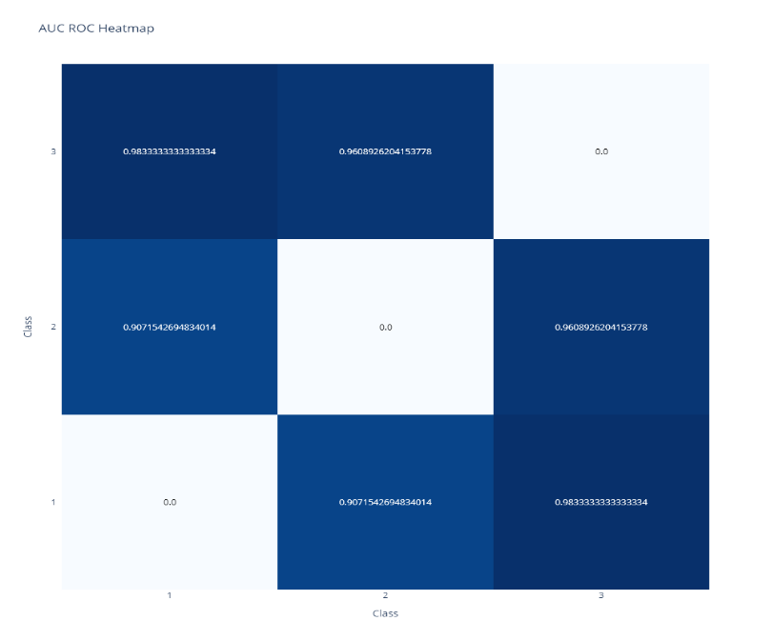
Final Results
Confusion Matrix Comparing Predictions vs Actual Classes
Heatmap of auc_roc_scores for prediction pairs
Classification Report
 | precision | recall | f1-score | support
1 | 0.892989 | 0.979757 | 0.934363 | 247
2 | 0.925 | 0.72549 | 0.813187 | 102
3 | 0.966667 | 0.90625 | 0.935484 | 32
accuracy | 0.905512 | 0.905512 | 0.905512 | 0.905512
macro avg | 0.928219 | 0.870499 | 0.894345 | 381
weighted avg | 0.907747 | 0.905512 | 0.902016 | 381

Slide 19
Conclusion
A RandomForest classifier with can be used to reasonably predict that fetal health using the data provided.
Feature reduction does not improve model performance
The best parameters for this classifier are: criterion='log_loss', max_features='log2', min_samples_leaf=2, min_samples_split=5, n_estimators=250

Slide 20
Next Steps
Canary deployment through a cloud service on AWS Sagemaker, Azure Functions etc.
Monitor Model Drift over time
Incorporating a multi-layer perceptron.
Logging results
Dividing data into the different stages of labor.

